Slide 1
Main Memory
Supplemental reading

Slide 2

REVIEW
CPU-stands for central processing unit; it is the key component in a digital computer; it interprets computer program instructions and processes data.
the primary memory/store of a computer: it is the programs, data and information directly accessed by the CPU.

Slide 3
RAM
RAM-the primary memory of a computer: it stores the programs and data while they are being processed
There are different types but each kind can be ACCESSED (read or written) directly by the CPU in a very short time regardless of the sequence (RANDOM access memory) in which they were recorded..

Slide 4
RAM cont’d
RAM is made up of small memory chips on the motherboard of your computer.
Every time you open a program, it gets loaded from the hard drive into the RAM.

Slide 5
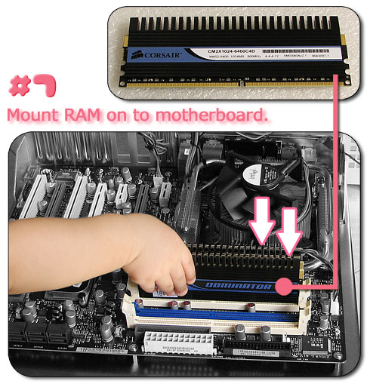
RAM chip

Slide 6
RAM cont’d
Running programs from the RAM of the computer allows them to function without any lag time. The more RAM your computer has, the more data can be loaded from the hard drive into the RAM, which can effectively speed up your computer.
To check how much RAM a Windows computer has, open the "System" Control Panel. This can be done by right-clicking "My Computer" and selecting "Properties..."

Slide 7
CACHE
Cache is primary memory that holds a copy of the most recently accessed and the most likely to be accessed data.
Why does it hold this kind of data?
So that the CPU can access the data and instructions needed faster.
compared to R.A.M., cache is smaller and faster

Slide 8

ROM
This is "built-in" computer memory containing data that normally can only be read, not written to.
ROM contains the programming that allows your computer to be "booted up" or regenerated each time you turn it on.

Slide 9
ROM cont’d
Unlike a computer's random access memory (RAM), the data in ROM is not lost when the computer power is turned off.
The ROM is sustained by a small long-life battery in your computer.

Slide 10
PROM
This is a form of digital memory that can be programmed only once.
Such PROMs are used to store programs permanently.
The key difference from a strict ROM is that the programming is applied after the device is constructed.

Slide 11
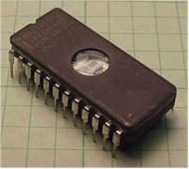
EPROM
The term EPROM stands for "E"rasable "P"rogrammable "R"ead "O"nly "M"emory.
Erasable means that the chip can be erased and reused .
EPROM is a special type of memory that retains its contents until it is exposed to ultraviolet light which clears its contents, making it possible to reprogram the memory.
The computer cannot store data in an EPROM because the EPROM is a READ ONLY memory part.

Slide 12
EPROM cont’d
In short, the EPROM is a memory part which will not forget its program or data when power is removed. It must be programmed by a special programming product
Once the EPROM is programmed it cannot be changed until it is erased in an EPROM eraser and then reprogrammed in a programmer.
An EPROM differs from a PROM in that a PROM can be written to only once and cannot be erased.

Slide 13
EEPROM
Stands for Electrically Erasable Programmable Read-Only Memory
Is a rewritable memory chip that can be erased and reprogrammed (written to) repeatedly through the application of higher than normal electrical voltage.
Unlike EPROM chips, EEPROMs do not need to be removed from the computer to be modified. It also has a limited life - that is, the number of times it can be reprogrammed is limited to tens or hundreds of thousands of times.
EEPROMs are bit or byte addressable at the write level, which means either the bit or byte must be erased before it can be re-written.

Slide 14
BISTABLE
Also called flip flop - when an electronic device or circuit can assume either of two stable states by the applying an electric pulse
Hence, all these main memory chips are examples of bistable devices!!

Slide 15
Further reading:
Log On to IT for CSEC, pg 26
Discovering Computers, pg 197
This site - http://www.maran.com/computerssimplified/pages/chapter3/index.html

